Slide 1
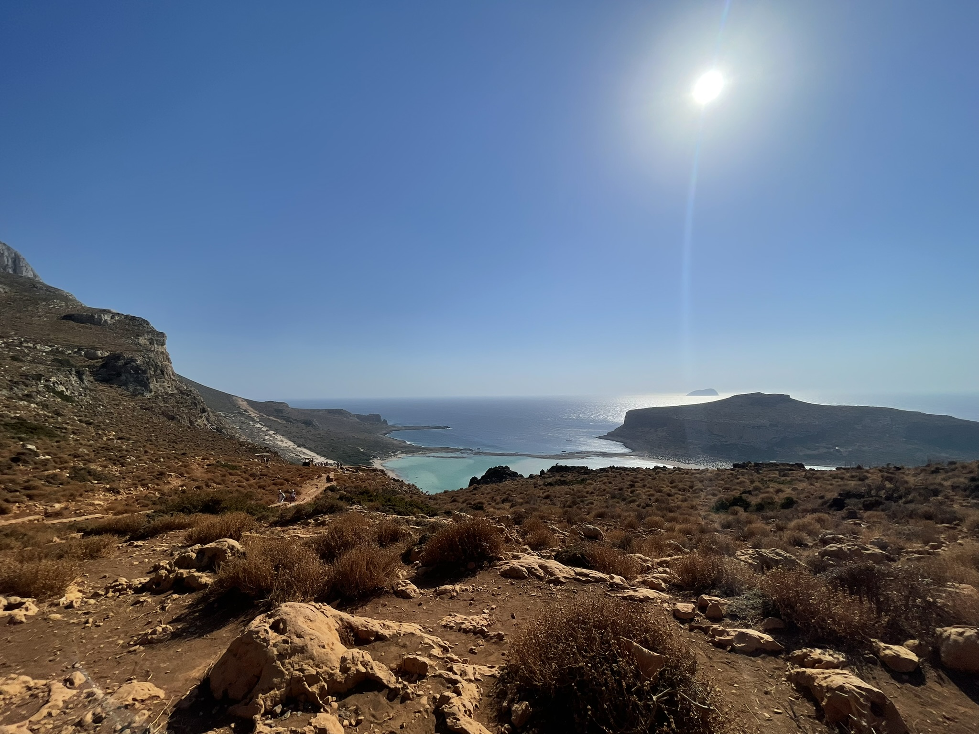
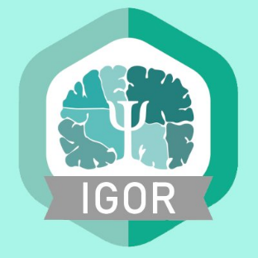
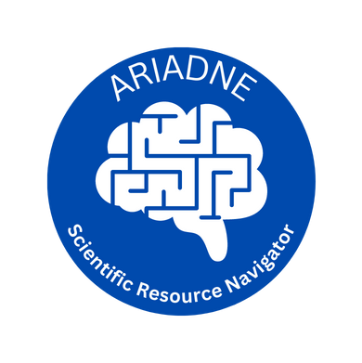
ARIADNE
Your navigator in science!
Çagatay Gürsoy
Zentralinstitut für Seelische Gesundheit, Mannheim
GRK Breaking Expectations, Marburg
Virtual, 11.12.2024

Slide 2
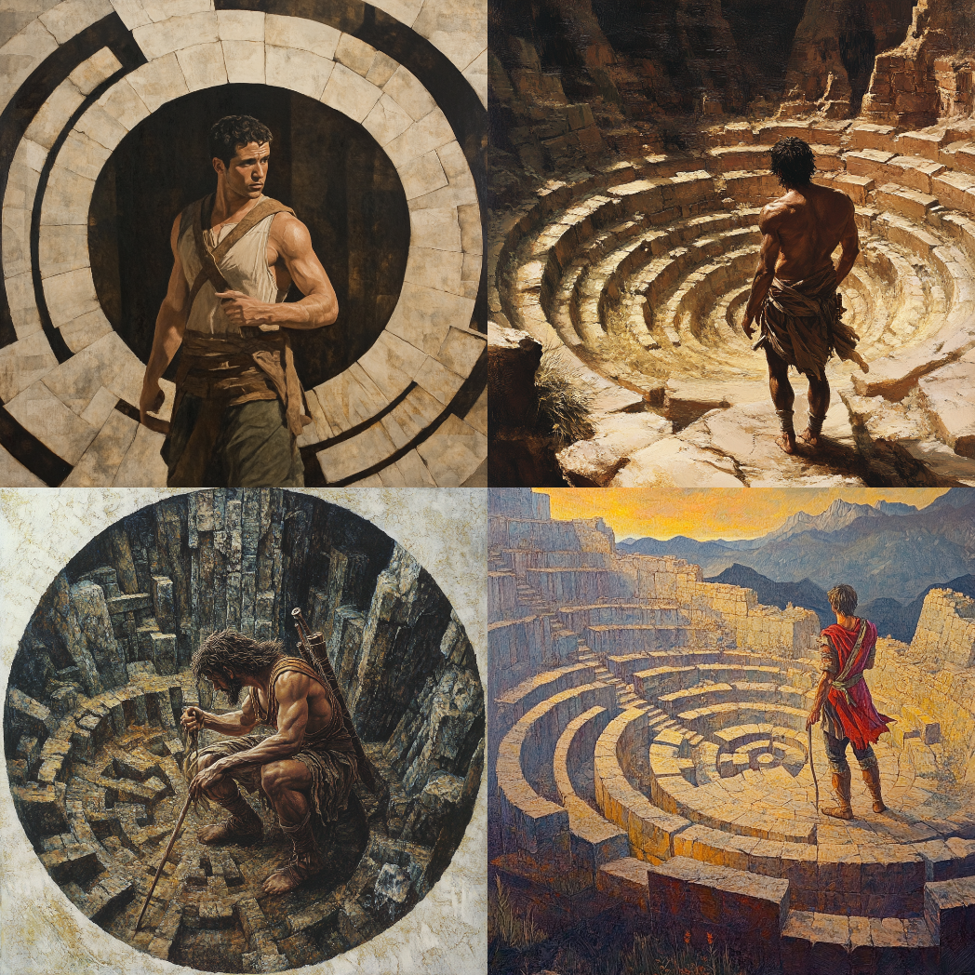
Being an early career researcher in academia
ECR
If you‘re here with us today, it is most likely that you‘re also bewitched with the allure of asking more and more!
What do we want/get out of this?
Glory, like the Age of Heroes?
Or getting burdened with the weight of knowing more and more!
Notes:
We grow up with the stories of very succesful scientists
And we are always curious!
That drives us into the labyrinth of Science!

Slide 3
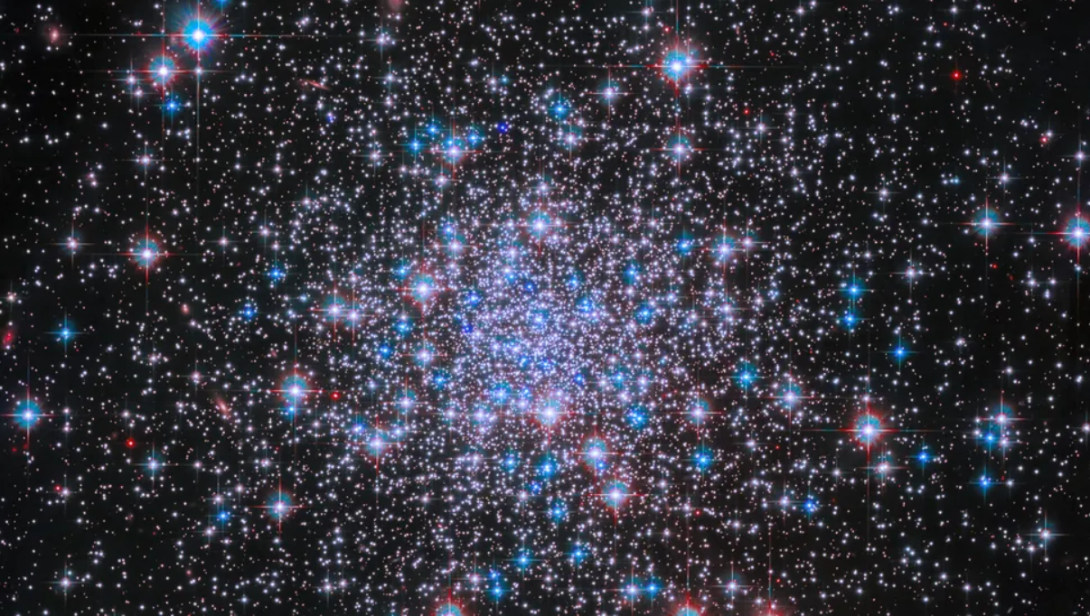
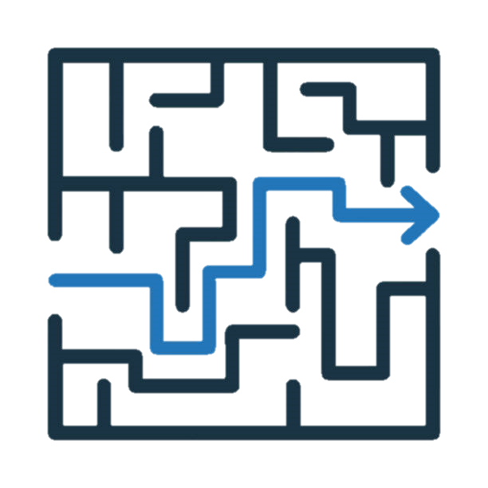

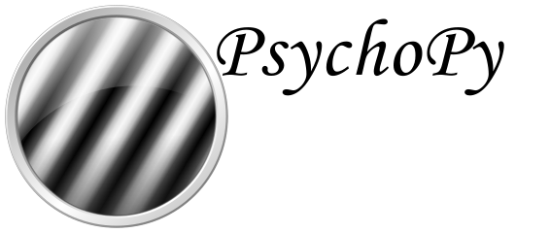

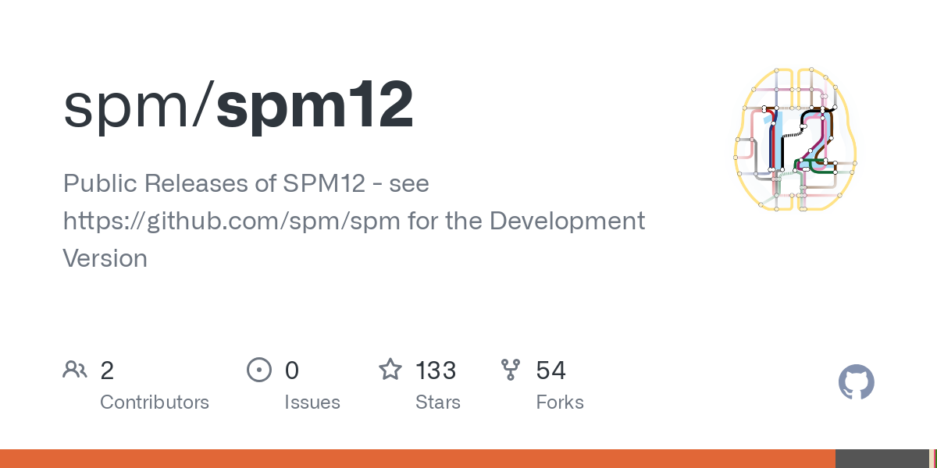



Having so many resources a gift or a curse?
In 21st century academia, we have ample amount of resources
Most of the times, either you adapt what has been used as the „industry standard“ in your research group / field
Or you try to select from the set of resources, and most likely get lost while doing that

Slide 4
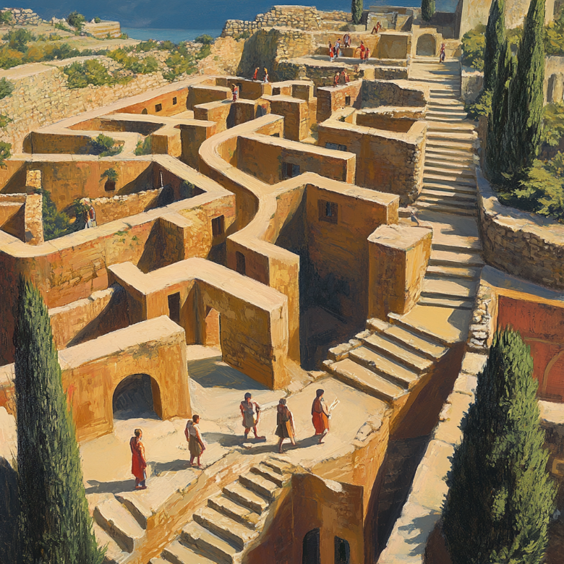
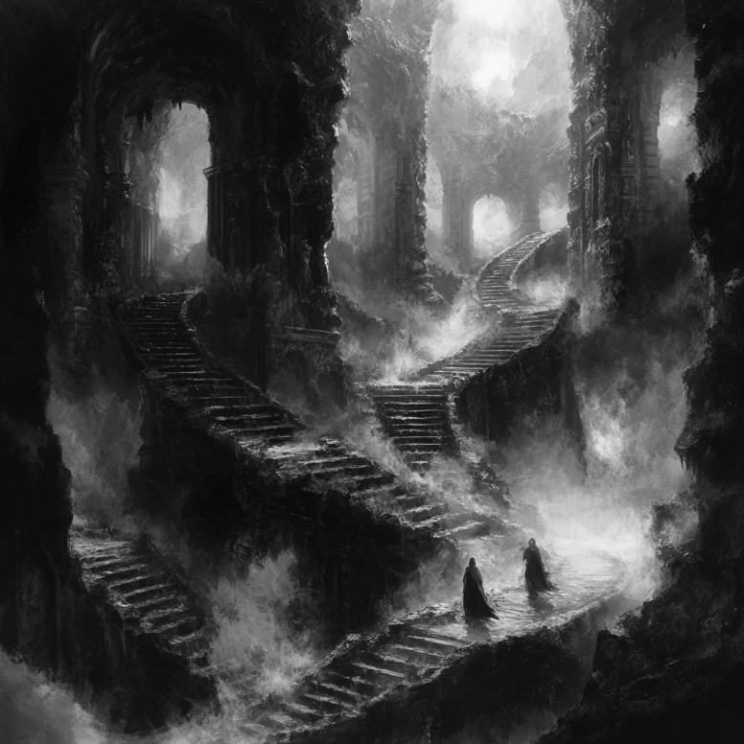
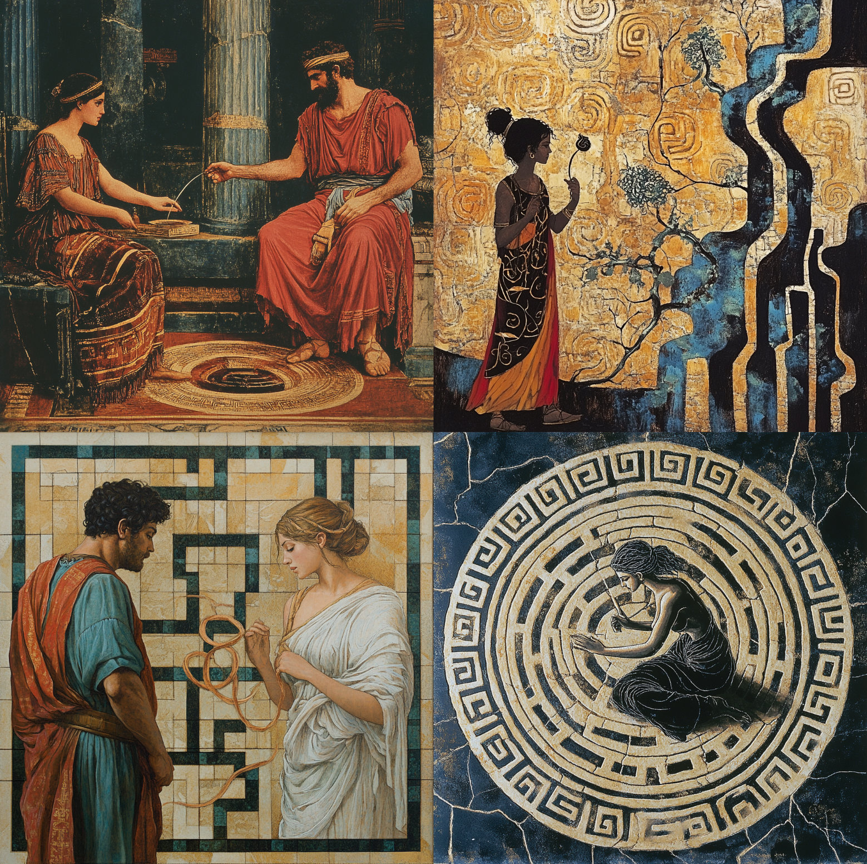
Lost in the labyrinth who‘s going to help the ECRs?
And at this point, you need your Ariadne, who would guide you in the labyrinth!
This can be a colleague, your PI or someone you met at a conference!
But why trust human memory/notetaking abilities when you can have a tool for that?

Slide 5
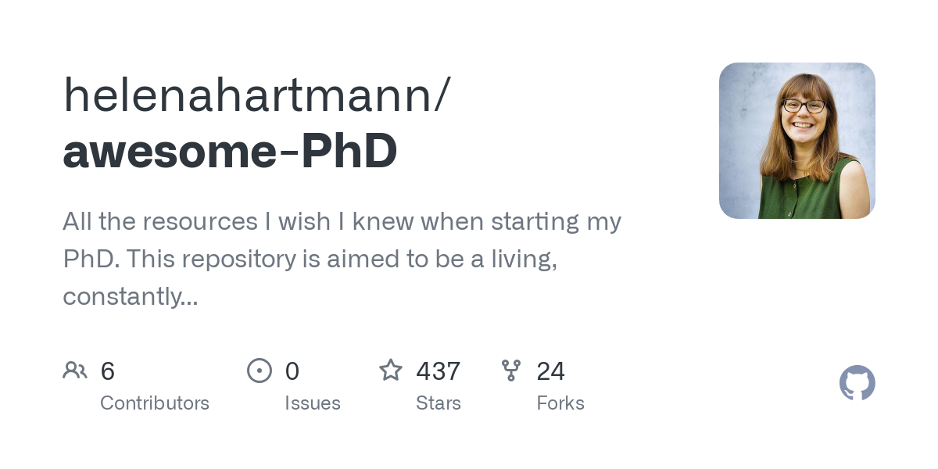
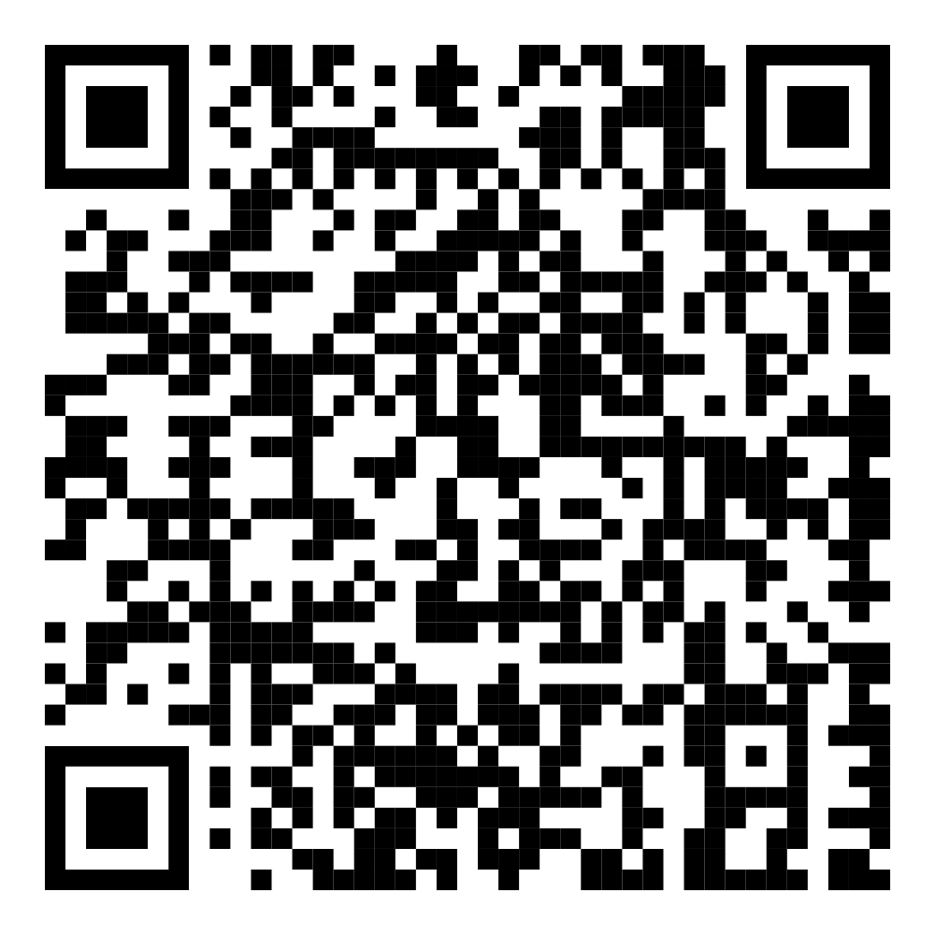
How did it start?
PuG 22
Discussion w/ Helena regarding her „awesome-PhD“ repo
Idea of expanding this into a larger project and make it community driven!

Slide 6
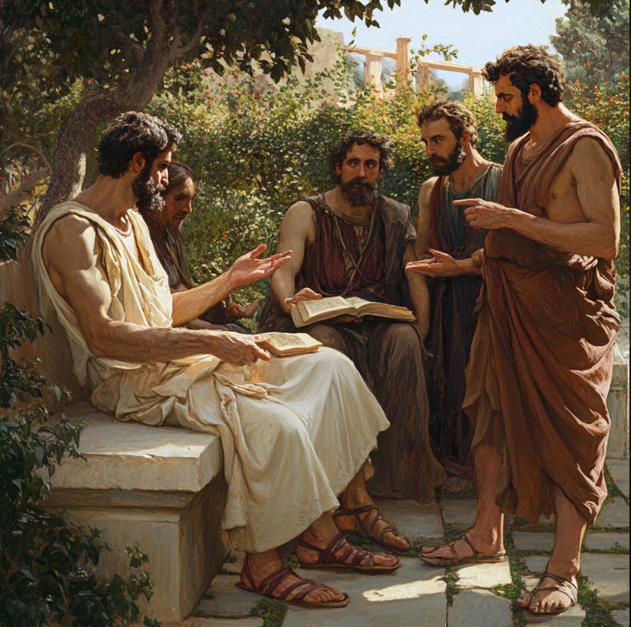
What‘s so special about ARIADNE?
It resonates the fire within the ECR:
Drive to create new knowledge
Drive to serve the growth of knowledge
Community driven & decentralised
For the community,
Comes within the community,
Will live with the community

Slide 7


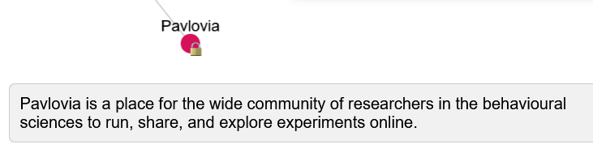
Why should you use ARIADNE?
As long as
is free
(looking at you Microsoft!)
Is free, will be free and developed/maintained by you!
Aimed to become the ultimate tool for ECRs, who are looking not just to hoard information; but to share as well!
For each resource, you will have curated short information; so you can decide its usefulness without even using it!

Slide 8
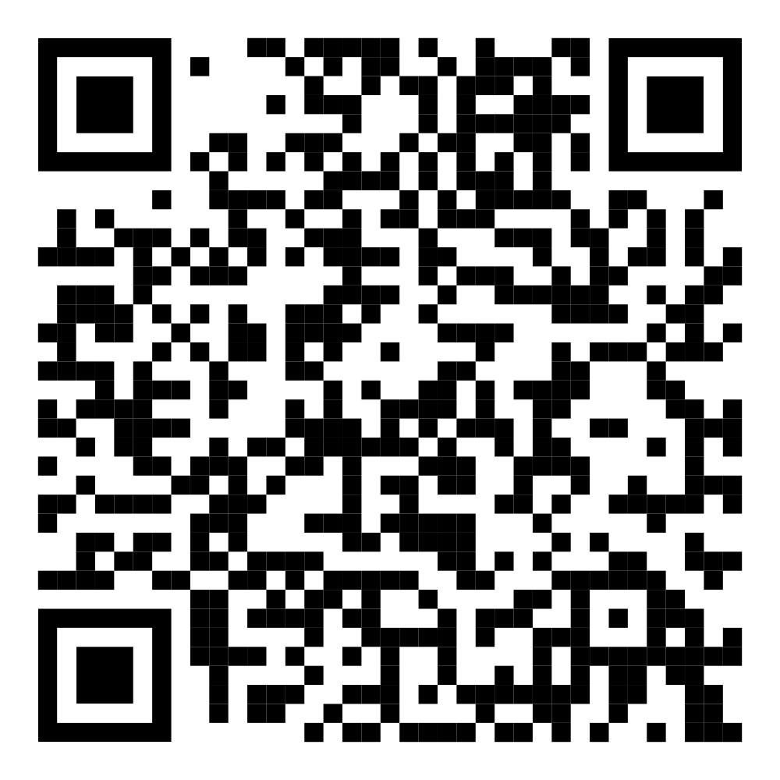
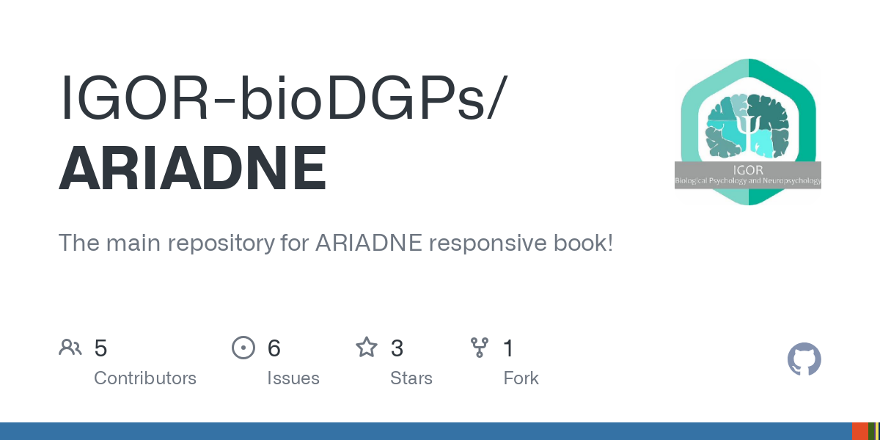
How can you use ARIADNE?
ARIADNE book
Companion book of the tool
Here you can have more information about 10 steps of the research cycle we have defined
ARIADNE tool
Network of resources, populated within sub-networks of said 10 steps
Request addition of new resources by a GDoc / GitHub Issue

Slide 9
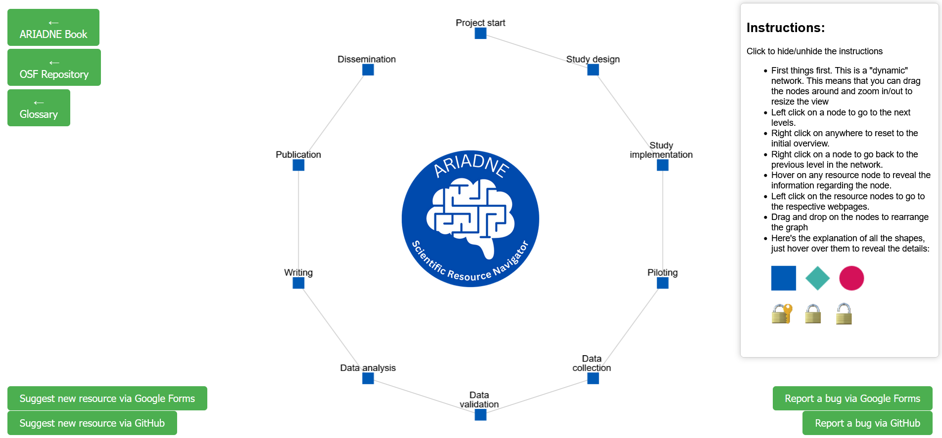
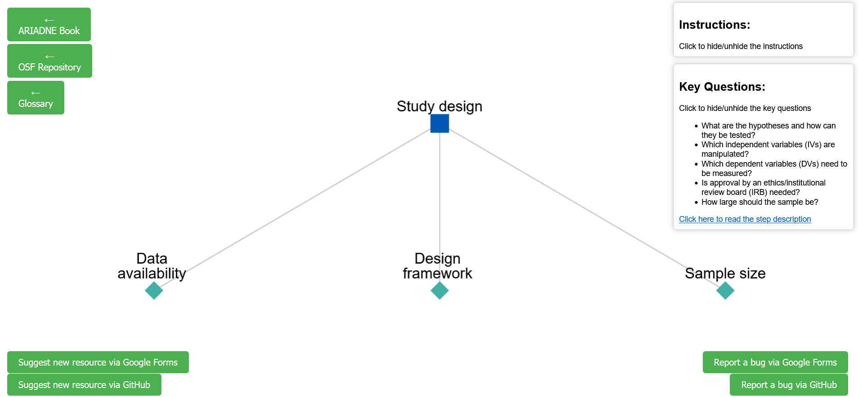
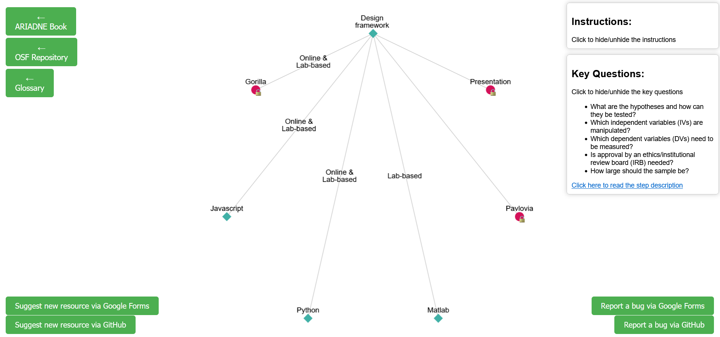
How can you use ARIADNE?

Slide 10
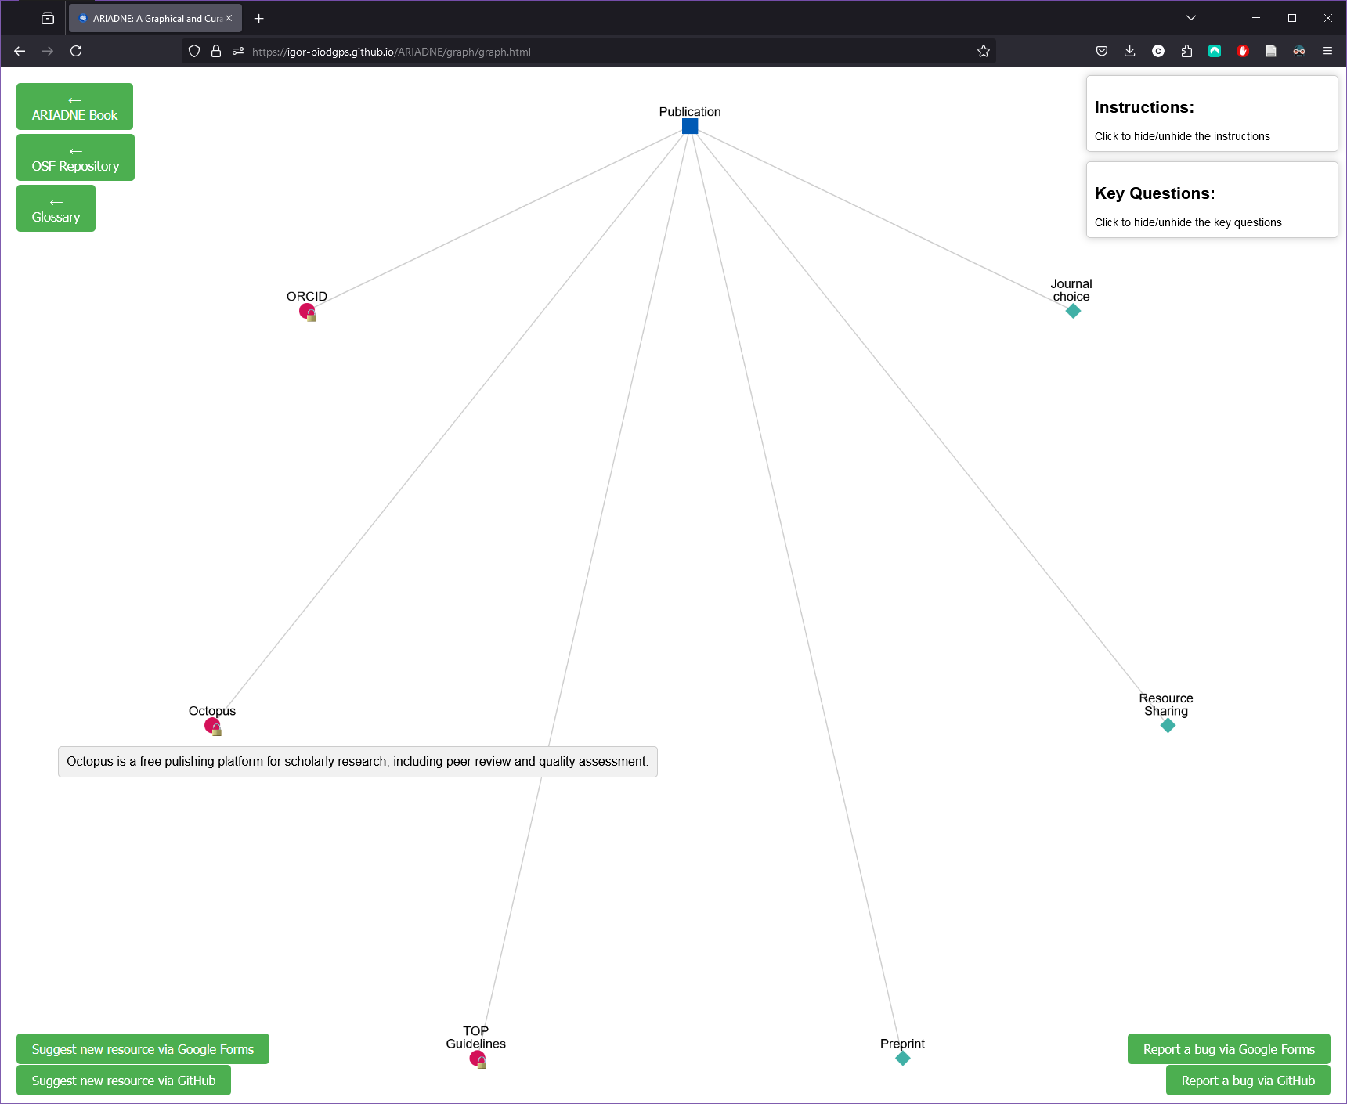
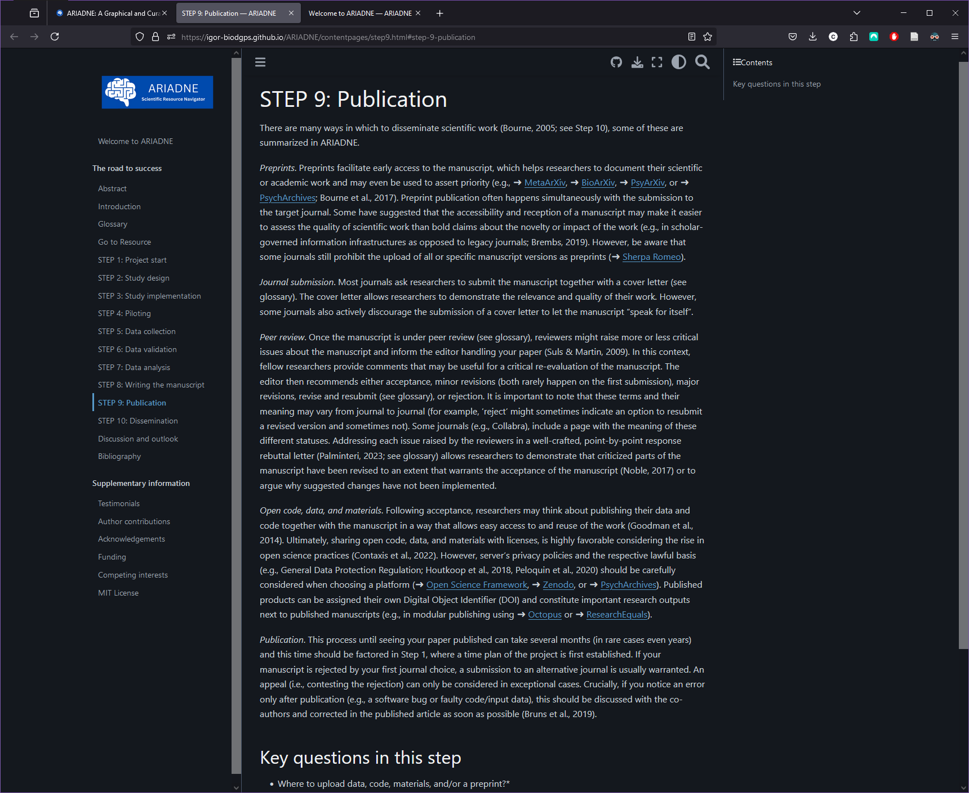
How can you use ARIADNE?

Slide 11
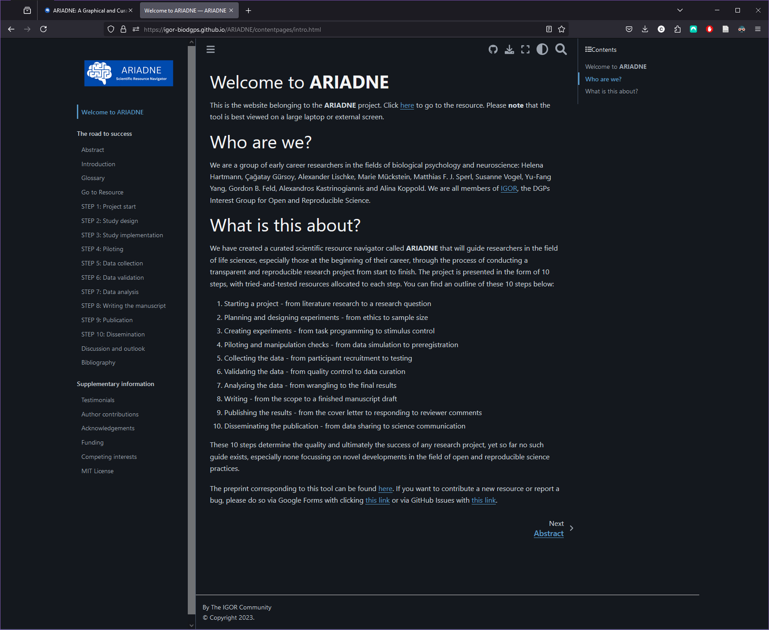
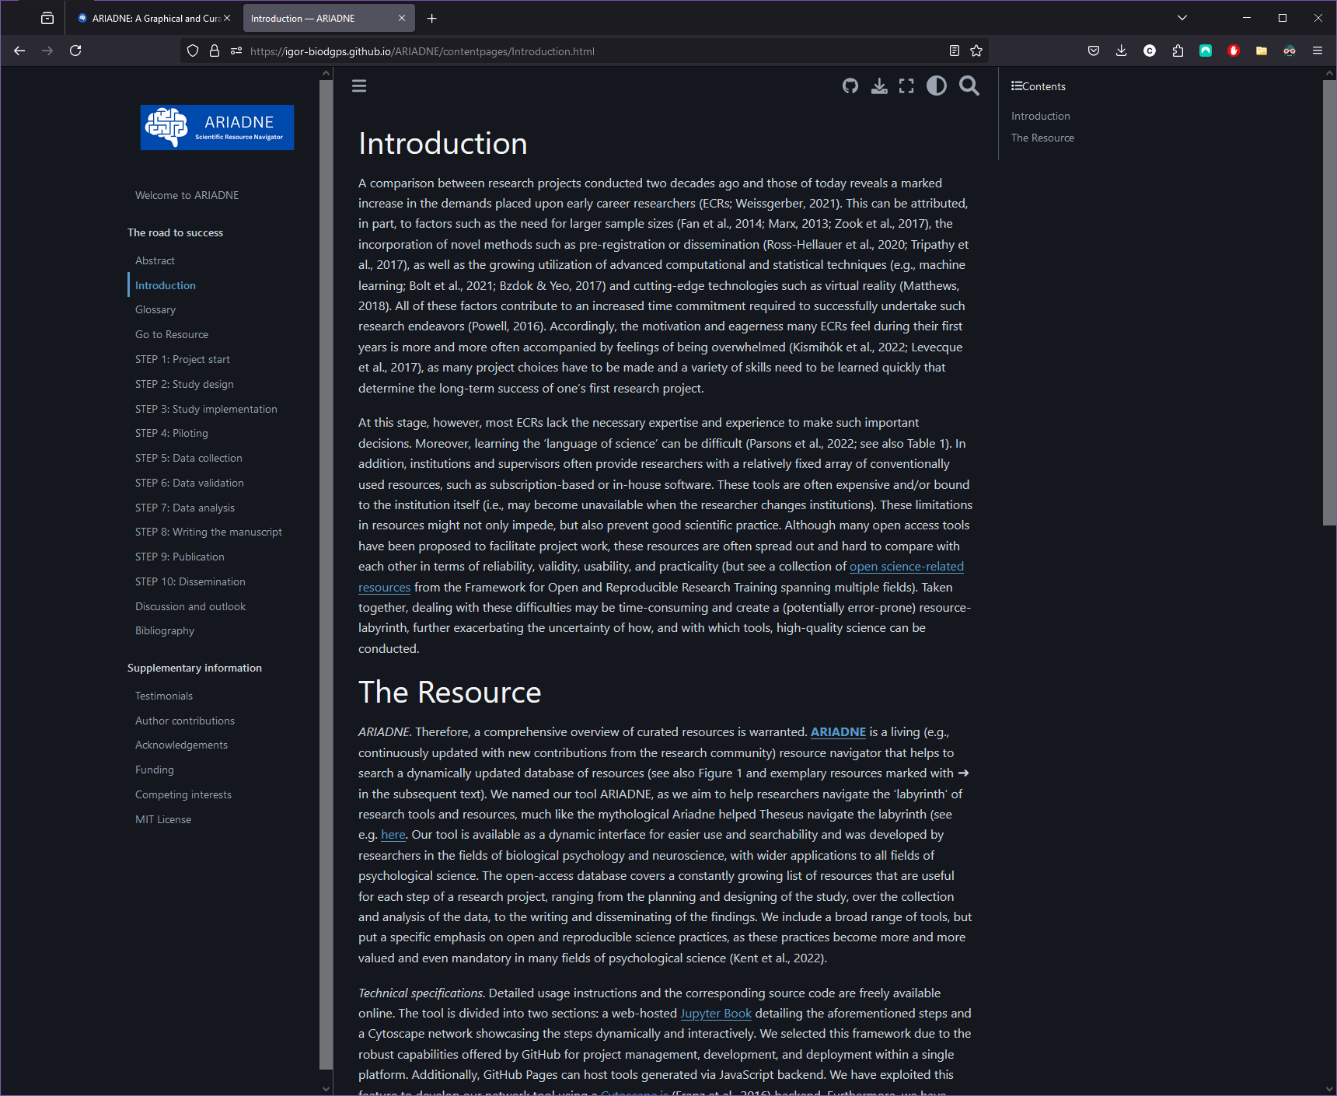
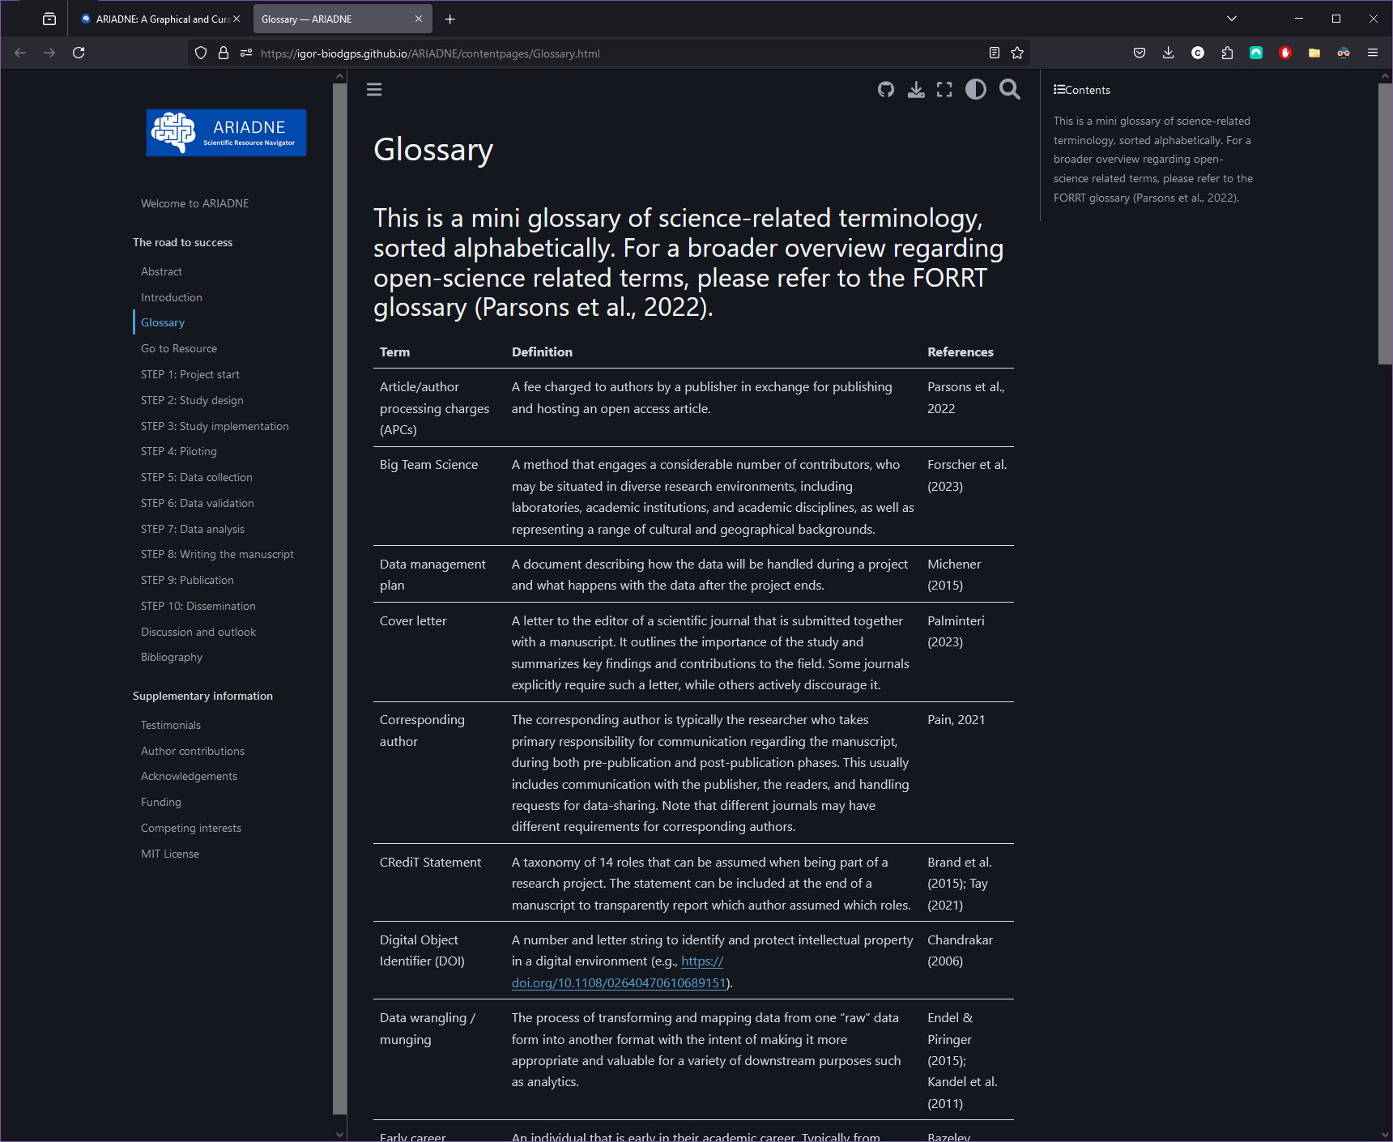
How can you use ARIADNE?

Slide 12
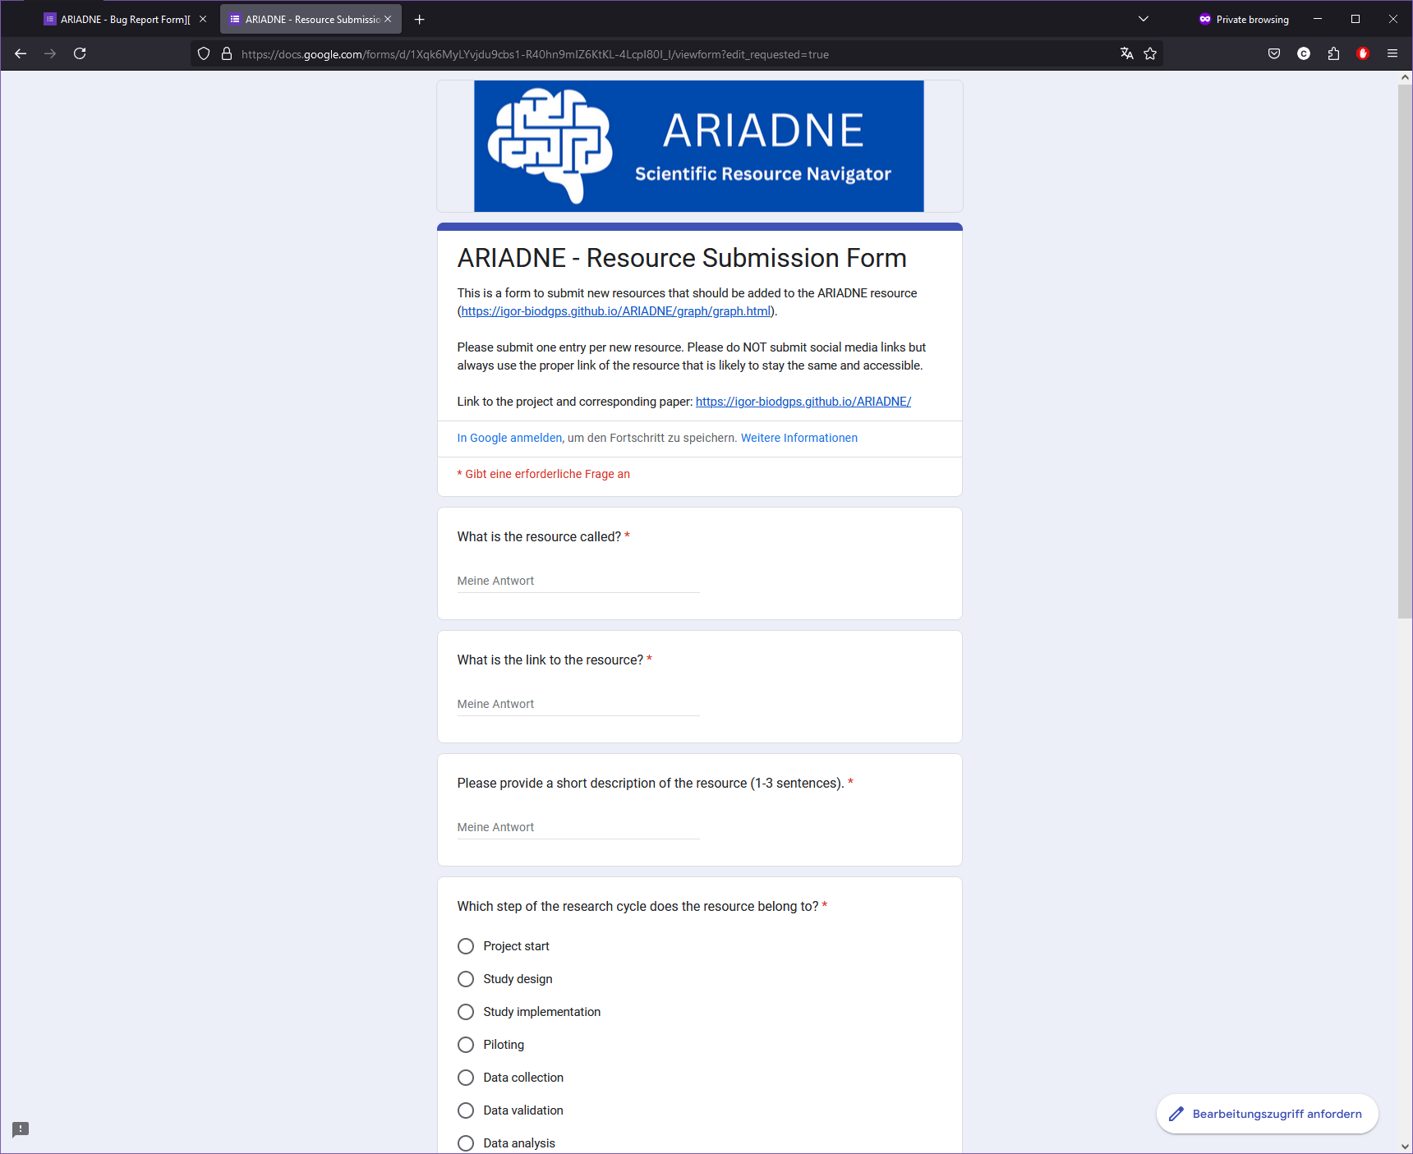
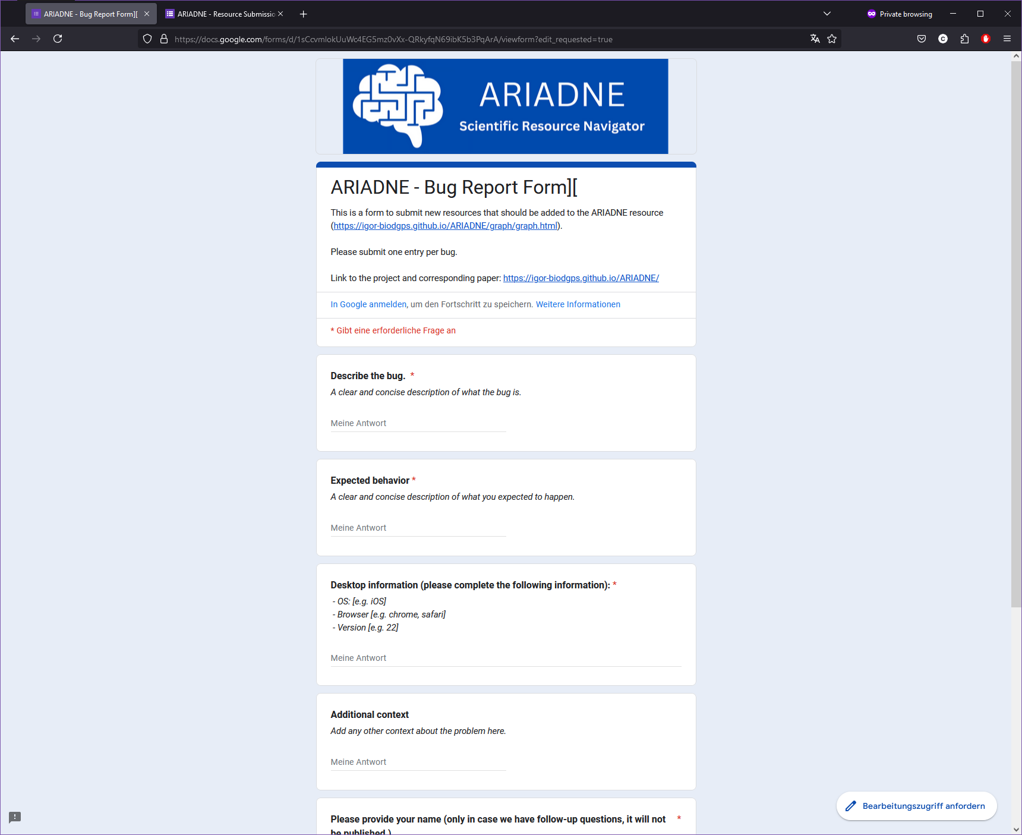
How can you use ARIADNE?

Slide 13

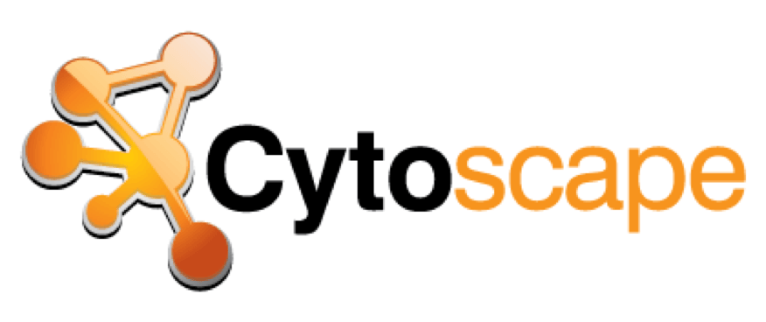
Under the hood
Book built with: Jupyter Book
Publication quality online books!
Tool built with: Cytoscape.js
Dynamic networks without much server-side magic!
Why?
We can save the Cytoscape.js library instance and create a „container“ within our GitHub repo + host our Jupyter Book at the same repo!

Slide 14

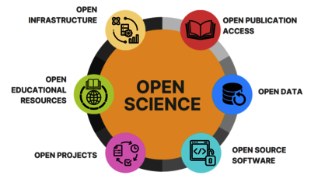

Why should you help grow ARIADNE?
Open Science and Open Source movement
Against Gatekeeping!
Enhancing the effectiveness of resource sharing in global science
The project is not only for German/European audience; it aims to become global!

Slide 15
The future!
More resources!
Updates on the glossary
Search function
Show on the network function

Slide 16
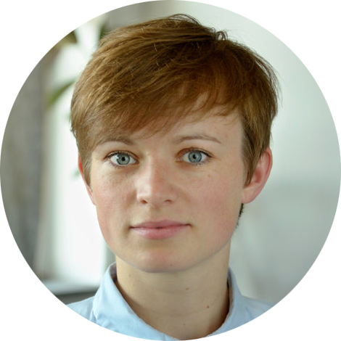
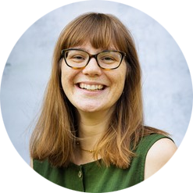
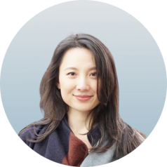
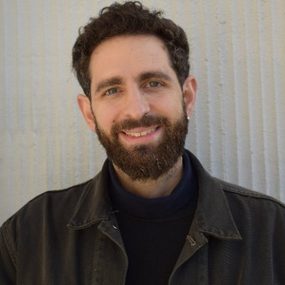
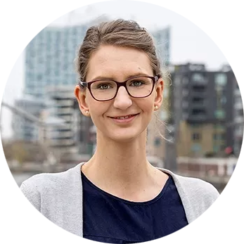
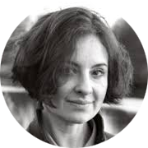
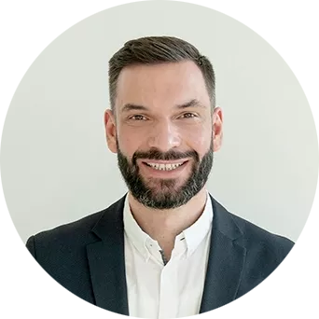
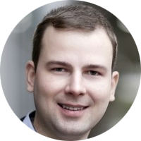
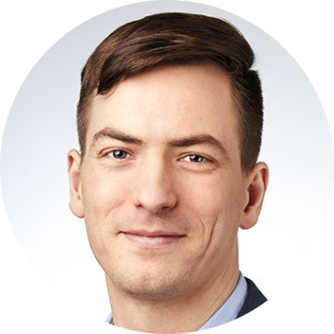
The team!
Marie Mueckstein
Helena Hartmann
Yu-Fang Yang
Susanne Vogel
Alexandros Kastrinogiannis
Alina Koppold
Alexander Lischke
Gordon B. Feld
Matthias F. J. Sperl
Slide courtesy of Alex Kastrinogiannis

Slide 17
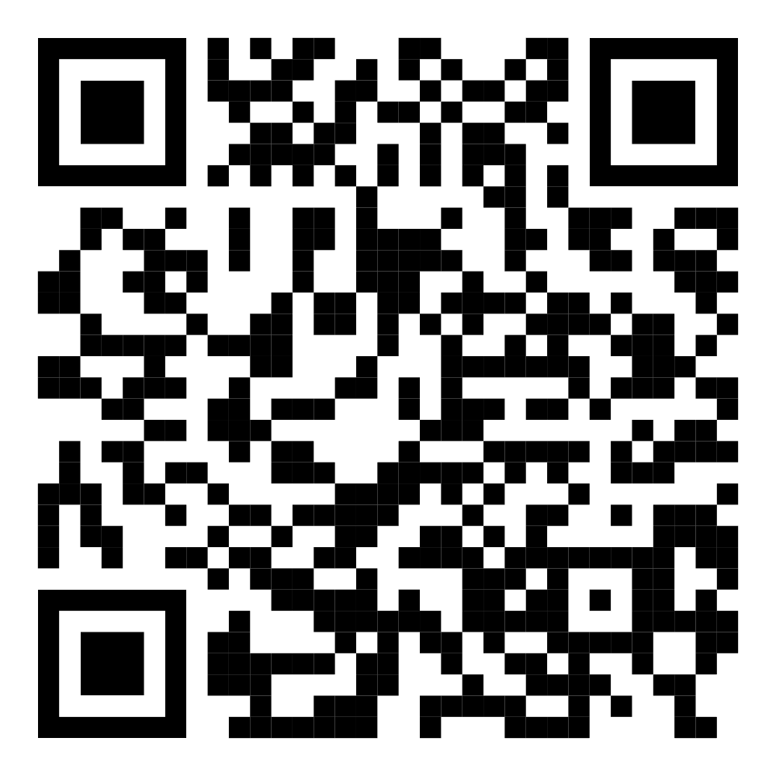
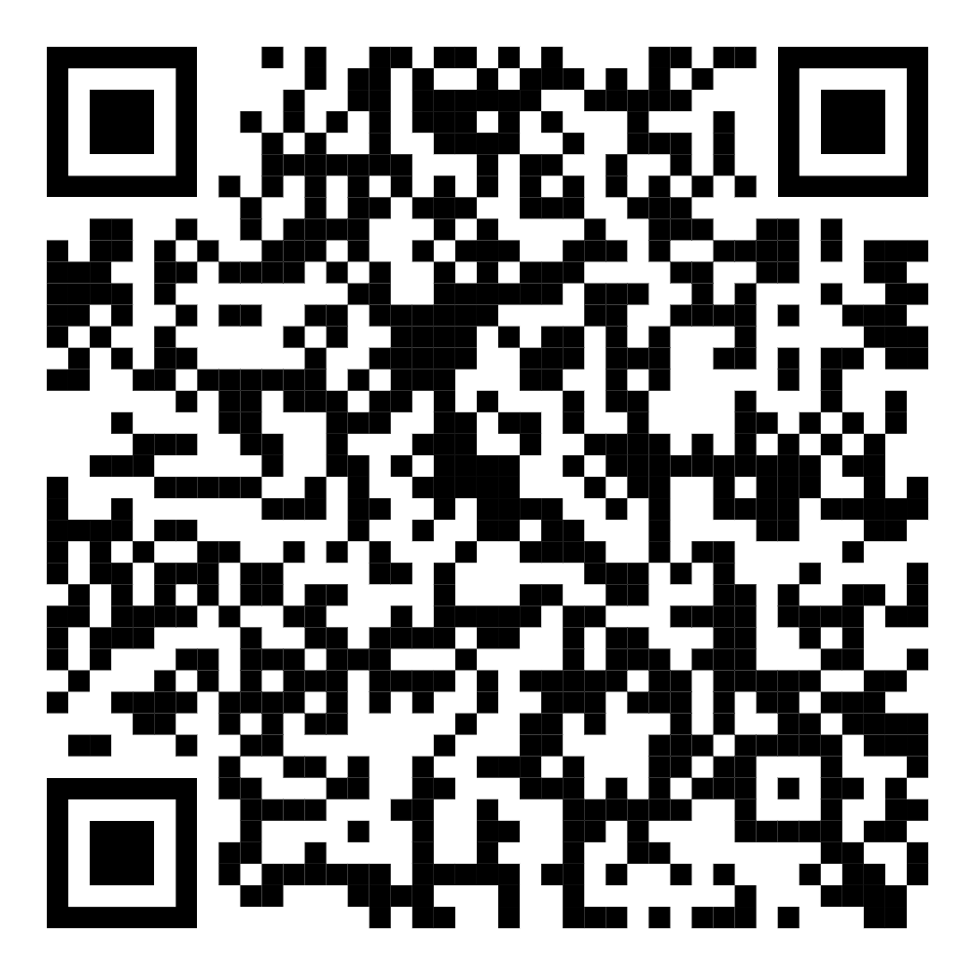

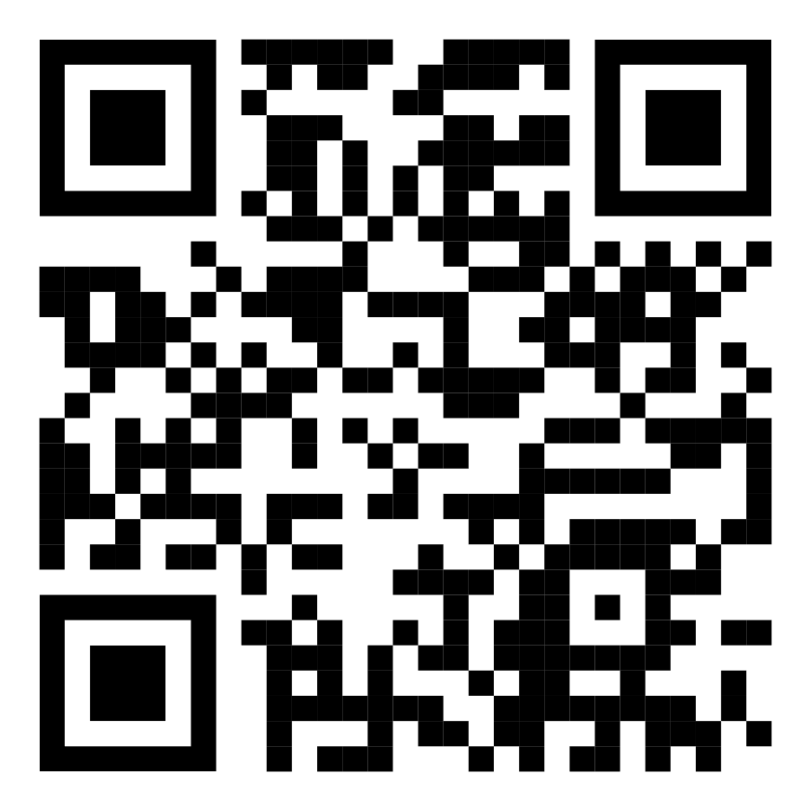

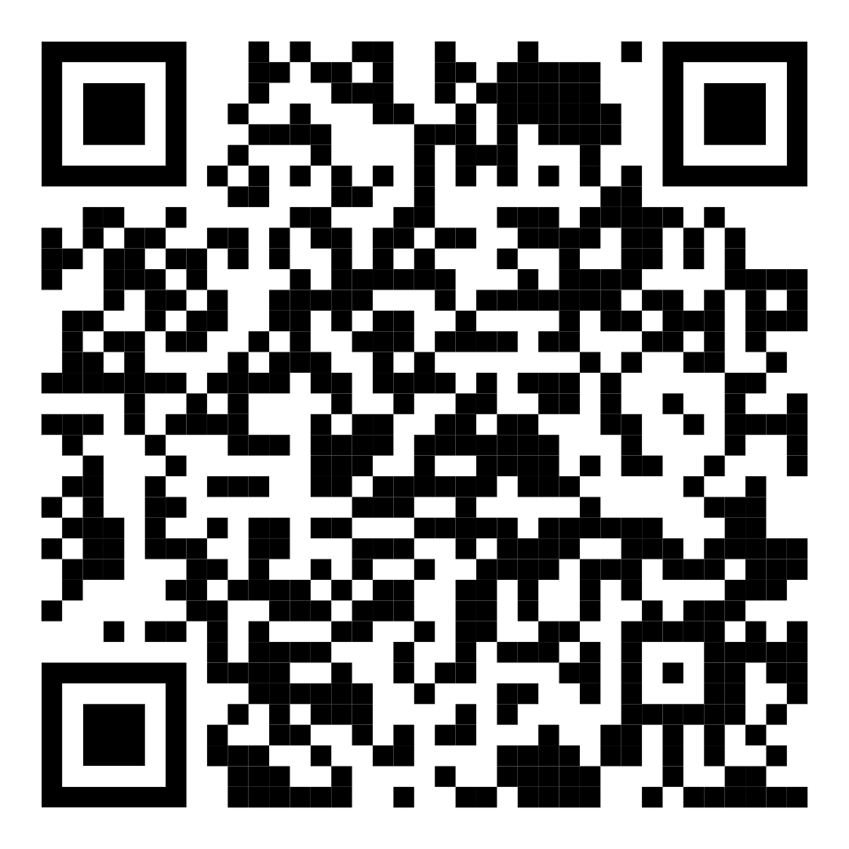

Find me on!
GitHub: @caggursoy
Bluesky: @caggursoy.bsky.social
Twitter: @caggursoy
LinkedIn:
www.linkedin.com/in/cagatay-gursoy
Email:
cagatay.guersoy@zi-mannheim.de
Or my webpage:
https://cagataygursoy.com/

Slide 18
Links
Preprint
OSF: https://osf.io/hjysu
ARIADNE
Book: https://igor-biodgps.github.io/ARIADNE/
Tool: https://igor-biodgps.github.io/ARIADNE/graph/graph.html
This presentation:
https://github.com/caggursoy/phdSideQuests/tree/master/presentations/marburg_ariadne

Slide 19
